Slide 1
AIR QUALITY INDEX
AJAY V G
PGDDM34

Slide 2

Overview
The goal of this dataset is to provide valuable insights into the air quality of different regions, allowing researchers and policymakers to make informed decisions on how to address the issue of air pollution.

Slide 3
This dataset is a merger of two separate datasets, one containing information about cities and their corresponding latitude and longitude coordinates, and the other containing data on air pollution levels in countries across the world. By combining these two datasets, we can now analyze and compare air quality indices across different cities in various countries.
1
2
The inspiration for creating this dataset came from the growing concern over the impact of air pollution on our health and the environment. By making this data easily accessible and understandable, I hope to contribute to the ongoing efforts to improve air quality and create a cleaner, healthier world for future generations

Slide 4
IMPORT LIBRARAY
import pandas as pd
import numpy as np
import matplotlib.pyplot as plt
import seaborn as sns

Slide 5
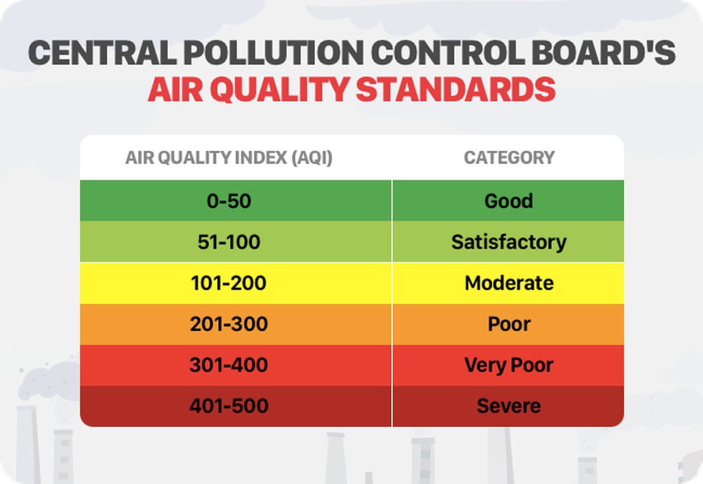

Slide 6
Understanding the condition

Slide 7
Air Quality Index (AQI) Value: The average AQI value is approximately 63, with a minimum of 7 and a maximum of 500. This indicates a wide range of air quality conditions across the cities in the dataset.
Pollutant Categories: The dataset includes AQI values and categories for various pollutants such as CO, Ozone, NO2, and PM2.5. The most frequently recorded pollutant category is "Good" for all pollutants, suggesting that a majority of the cities have relatively satisfactory air quality.
Geographical Distribution: The dataset covers cities from 174 different countries. The most frequently represented country is the United States of America, with 3,954 occurrences. This indicates that the dataset is heavily skewed towards cities in the United States.
Geographic Coordinates: The dataset includes latitude and longitude coordinates for each city, providing spatial information for further analysis and visualization.

Slide 8
Trend analysis
100
80
60
40
20
0
Jan
Feb
Mar
Apr
May
Jun
Jul
Aug
Sep
Oct
Nov
Dec
Trend 01
Trend 02

Slide 9
Easy actions you can take to reduce air pollution:
1. Walk or ride a bike whenever possible
Turn off the lights when you leave a room
Do a home audit
Recycle and reuse items
Consistently practice tree planting

Slide 10
Regularly maintain your car
Purchase and opt for green electricity at all times
Drive Smart
Stop junk mail subscription
Keep a regular check on the HVAC system
Quit smoking
Only use Energy Star appliances
Restrict the use of gasoline machine
Do not use harmful chemicals

Slide 11
To help reduce air pollution, encourage your friends and family to:
Carpool with colleagues or friends
When buying a new car, choose the lowest-polluting car
Use public transport
Replace air conditioning with a fan
Use recycled materials
Use water-based paints and cleaning products
Opt for natural gas instead of charcoal
Utilize solar and wind energy

Slide 12
CONCLUSION
Based on the exploratory data analysis (EDA) conducted on the provided air quality dataset, the following conclusions can be drawn
Overall Air Quality: The majority of the recorded AQI values fall within the "Good" to "Moderate" categories, indicating relatively acceptable air quality in many locations. However, there are also instances of higher AQI values, indicating poorer air quality.
Pollutant Contribution: Among the pollutants measured, PM2.5, NO2, CO, and Ozone are the major contributors to air pollution. These pollutants show varying levels of correlation with each other, suggesting potential interactions and shared sources.

Slide 13
Top Polluted Countries: The analysis highlights the countries with consistently poor air quality based on the recorded AQI values. Identifying these countries can aid in directing resources and interventions to improve air quality in those regions.
Geospatial Analysis: Visualizing the geographic distribution of air quality using latitude and longitude coordinates helps identify areas with higher pollution levels. Certain regions may exhibit clusters of polluted areas, indicating localized sources of pollution.
In conclusion, the EDA provides valuable insights into air quality, pollutant contributions, geographical patterns, and potential avenues for further analysis. These findings can inform decision-making processes, policy formulation, and targeted interventions aimed at improving air quality and mitiga

Slide 14
Thank you.

